Slide 1
Unit 2-2
Perimeter, Circumference, and Area
PLANE Geometry

Slide 2



Square:
$$Area=A=s^{2}$$
$$Perimeter=P=4s$$
$$s=Length of the Side of a Square$$
$$s$$

Slide 3

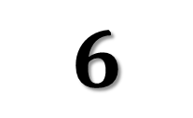
Example 1
Find the Area and Perimeter of the Given Square
$$6$$
$$10$$

Slide 4

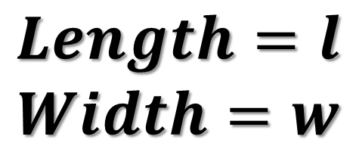


Rectangle:
$$Area=A=l∙w$$
$$Perimeter=P=2l+2w$$
$$w$$
$$Length=l$$
$$Width=w$$
$$l$$

Slide 5

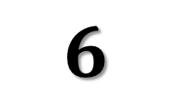

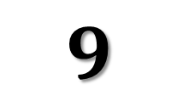
Example 2
Find the Area and Perimeter of the Given Rectangle
$$4$$
$$6$$
$$9$$
$$12$$

Slide 6



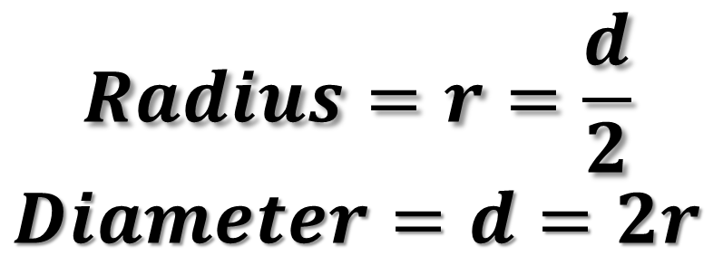
Circle:
$$Area=A=πr^{2}$$
$$Circumference=C=2πr=dπ$$
$$Radius=r=\frac{d}{2}$$
$$Diameter=d=2r$$
$$d$$
$$r$$

Slide 7


Example 3
Find the Area and Circumference of the Given Circle
$$7$$
$$11$$

Slide 8




Example 4
Find the Area of the Shaded Region
$$3$$
$$8$$
$$7$$
$$7$$

Slide 9







Example 5
Find the Area of the Shaded Region
$$15$$
$$5$$
$$8$$
$$4$$
$$4$$
$$5$$
$$5$$

Slide 10




Example 6
Find the Area of the Shaded Region
$$5$$
$$7$$
$$11$$
$$14$$

Slide 11
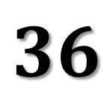
Example 7
Find the Area of the Shaded Region
$$36$$

